Slide 1
SDN- what and why
Dr. Subhasri Duttagupta

Slide 2
Limitations of Existing Networks
Traditional network uses Datagram approach, individual packets may follow different routes
Routing based on Destination is adopted.
Flow of packets with a defined QoS may affect the routing for the flow in the current scenario.
Static and Complex Architecture
Inability to Scale
Inconsistent policy
Vendor Dependence

Slide 3
Requirements of Modern Networking Approach
Adaptability
Automation
Maintainability
Model Management
Handling Mobility

Slide 4
Network Demand
Demand on Network is increasing
Cloud Computing
Big Data
Mobile Traffic
IoT
Capacity of Network technologies is increasing
Wired and Wireless network capacity have the ability into Gbps
4G/5G have higher capacity
Dynamic and Complex
Traffic pattern
Stallings Book Chapter 2

Slide 5
Why SDN?
Access to multiple databases and servers simultaneously
Network convergence of voice, data and traffic
Due to public Cloud increased and unpredictable loads on enterprise
Heavy use of mobile devices
Application and Database server virtualization

Slide 6
Software Defined Network
A network in which the control plane is physically separate from the data plane.
and
A single (logically centralized) control plane controls several forwarding devices.
Courtesy: Mohammad Alizadeh, MIT

Slide 7
Software Defined Network (SDN)
Control
Program
Control
Program
Control
Program
Global Network Map
Control Plane
Control
Packet
Forwarding
Control
Packet
Forwarding
Control
Control
Packet
Forwarding
Packet
Forwarding
Control
Packet
Forwarding
Notes:
Talk about forwarding & control planes

Slide 8
Does it introduce any problem?
One of the key characteristics of computer networks: fully decentralized control.
Once we introduce a centralized entity to control the network we have to make sure that it doesn’t fail

Slide 9


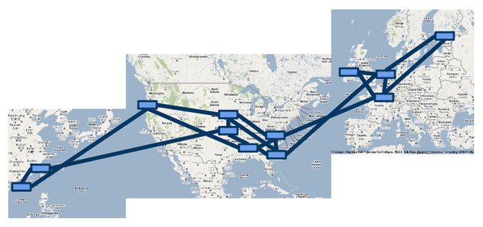

A Major Trend in Networking
Entire backbone
runs on SDN
Notes:
Nicira is a company focused on SDN, built their own switch software, OpenFlow proprietary version

Slide 10
The Networking “Planes”
Data plane: processing and delivery of packets with local forwarding state
Forwarding state + packet header → forwarding decision
Filtering, buffering, scheduling
Control plane: computing the forwarding state in routers
Determines how and where packets are forwarded
Routing, traffic engineering, failure detection/recovery, …
Management plane: configuring and tuning the network
Traffic engineering, ACL config, device provisioning, …

Slide 11
Timescales
 | Data | Control | Management
Time-scale | Packet (nsec) | Event (10 msec to sec) | Human (min to hours)
Location | Linecard hardware | Router software | Humans or scripts

Slide 12
Data and Control Planes (Traditional Router)
Processor
control plane
data plane
Switching
Fabric
Line card
Line card
Line card
Line card
Line card
Line card
Notes:
In traditional network

Slide 13
Data Plane
Streaming algorithms on packets
Matching on some header bits
Perform some actions
Example: IP Forwarding
1.2.3.4
1.2.3.7
1.2.3.156
5.6.7.8
5.6.7.9
host
host
...
host
host
host
...
host
LAN 1
LAN 2
router
router
router
WAN
WAN
1.2.3.0/24
5.6.7.0/24
forwarding table

Slide 14
Control Plane
Compute paths the packets will follow
Populate forwarding tables
Traditionally, a distributed protocol
Example: Link-state routing (OSPF, IS-IS)
Flood the entire topology to all nodes
Each node computes shortest paths
Dijkstra’s algorithm

Slide 15
Figure out which routers and links are present.
Run Dijkstra’s algorithm to find shortest paths.
B
“If a packet is going to B, then send it to output 3”
Software
Software
Hardware
Data
B
2
Software
1
Hardware
B
“If , send to 3”
Software
Hardware
B
3
Hardware

Slide 16
Management Plane (App layer)
Traffic Engineering: changing the traffic flow to satisfy some criteria
setting the weights
Can be Inversely proportional to link capacity?
Proportional to propagation delay?
Network-wide optimization based on traffic?
2
3
1
1
3
2
3
1
5
4
3

Slide 17
Example 1: Inter-domain Routing
Today’s inter-domain routing protocol, BGP, artificially constrains routes
Routing only on destination IP address blocks
Can only influence immediate neighbors
Very difficult to incorporate other information
Application-specific peering
Route video traffic one way, and non-video another
Blocking denial-of-service traffic
Dropping unwanted traffic further upstream
Inbound traffic engineering
Splitting incoming traffic over multiple peering links

Slide 18
How SDN Changes the Network
Feature
Feature
Network OS
Feature
Feature
OS
Custom Hardware
Feature
Feature
OS
Feature
Feature
Custom Hardware
OS
Feature
Feature
Custom Hardware
OS
Custom Hardware
Feature
Feature
OS
Custom Hardware
18

Slide 19
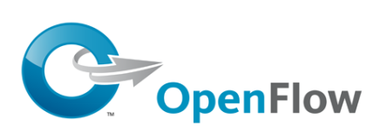
Software Defined Network (SDN)
3. Consistent, up-to-date global network view
2. At least one Network OS probably many. Open- and closed-source
Control Program 1
Control Program 2
Network OS
1. Open interface to packet forwarding
Packet
Forwarding
Packet
Forwarding
Packet
Forwarding
Packet
Forwarding
Packet
Forwarding
19

Slide 20
Network OS
Network OS: distributed system that creates a consistent, up-to-date network view
Runs on servers (controllers) in the network
NOX, ONIX, Floodlight, OpenDaylight, HyperFlow, Kandoo, Beehive, Beacon, Maestro, … + more
Uses forwarding abstraction to:
Get state information from forwarding elements
Give control directives to forwarding elements

Slide 21
Software Defined Network (SDN)
Control Program A
Control Program B
Network OS
Packet
Forwarding
Packet
Forwarding
Packet
Forwarding
Packet
Forwarding
Packet
Forwarding

Slide 22









Software Defined Network
Virtual Topology
Network Hypervisor
Control Program
Global Network View
Network OS
Notes:
Whenever we have a set of programs running and giving a view of NOS, we can build one more level of abstraction by putting a network hypervisor and put all the programs in network hypervisor. We’re still continuing to provide network OS services but thro VMs. The controller program manages the services through the hypervisor. Virtual topology provides an abstract view of the whole network

Slide 23





















Virtualization Simplifies Control Program
Abstract Network View
A
A→B drop
B
Hypervisor then inserts flow entries as needed
A
A→B drop
Global Network View
A→B drop
B
23

